Slide 1


INSTITUTE FOR ADVANCED COMPUTING AND SOFTWARE DEVELOPMENT AKURDI, PUNE
PROJECT TITLE :HONEYPOT WITH SNORT
GROUP NO. 22
Rohan Dipak Kamble(233438)
Aniket Bapusaheb Thorat(233447)
PROJECT GUIDE
Mr. Kartik Awari
CENTER COORDINATOR
Mr. Rohit Puranik

Slide 2
INTRODUCTION
In the ever-evolving landscape of cybersecurity, staying one step ahead of potential threats is essential. As malicious actors continue to develop new tactics, organizations and individuals alike need to fortify their defenses. This is where the concept of honeypots, coupled with powerful intrusion detection systems like Snort, comes into play.
Imagine creating a virtual playground that lures in cyber attackers, offering them what seems like enticing targets. Unbeknownst to them, every move they make is being meticulously observed, recorded, and analyzed. This intriguing realm is the realm of honeypots – simulated environments designed to attract and study malicious activity. When combined with Snort, an open-source network intrusion detection and prevention system, this concoction becomes a potent tool for learning, discovery, and proactive defense.

Slide 3

PURPOSE
Our honeypot project with Snort aims to offer a hands-on exploration of cybersecurity threats, giving you an opportunity to delve deep into the world of hackers, attackers, and the methods they employ. This project is not just about creating a digital playground; it's about understanding the psychology and mechanics of cyber threats. It's about using deception and observation to gain insights that can help secure real systems and networks.

Slide 4

REQUIREMENT
SOFTWARE :
1 . Operating System : Debain 10
2. . Firewall
3. Honeypot Type : Cowrie
Firewall : Snort
Database : Mysql
Cloud Platform : AWS
HARDWARE :
CPU : 2.5 GHZ
RAM: 8 GB
Storage : 500 GB
Network : 100 Mbps

Slide 5
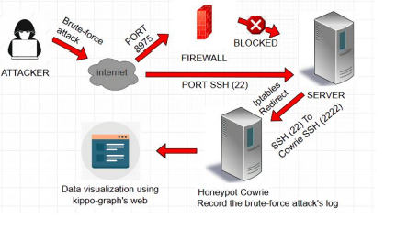
ARCHITECTURE

Slide 6
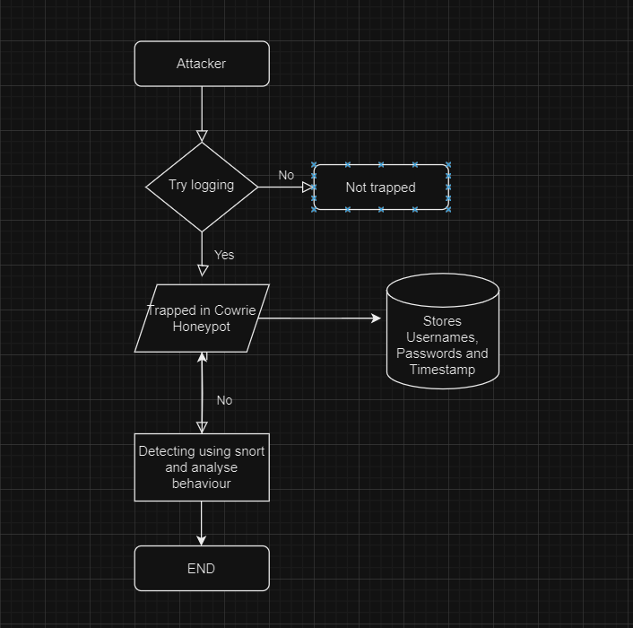
FLOWCHART

Slide 7

PEOJECT EXECUTION

Slide 8
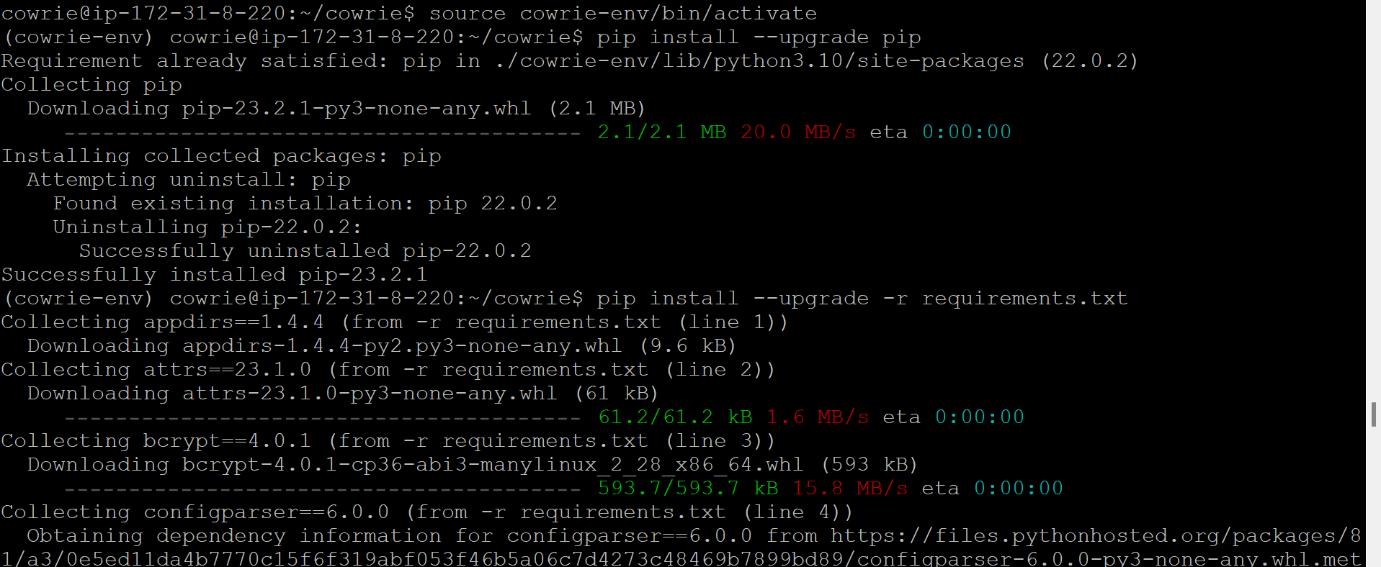
1. ACTIVATE COWRIE

Slide 9
2. REDIRECT

Slide 10
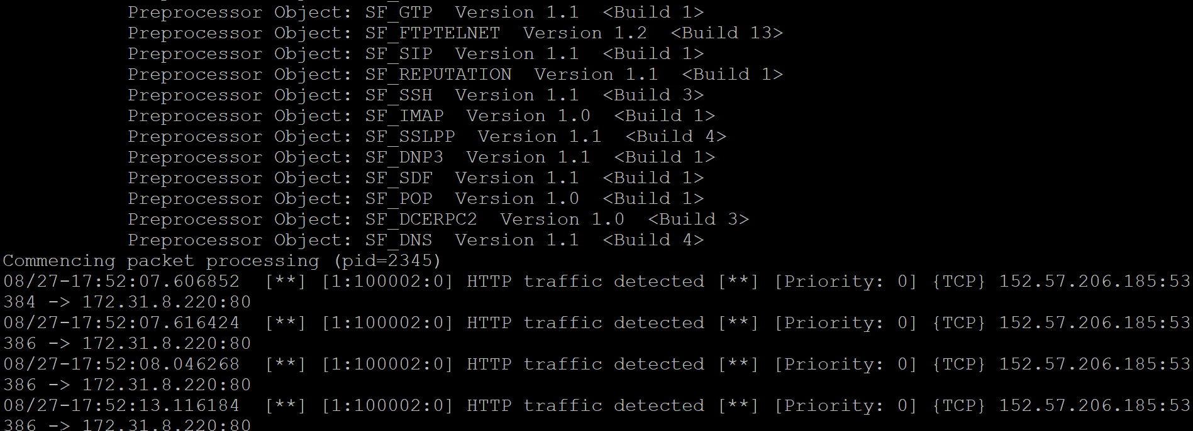
3. DETECT USING SNORT

Slide 11
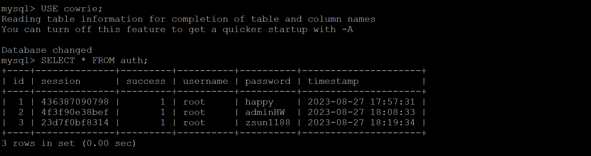
4. STORES IN DATABASE

Slide 12
5. ANALYZE AND MAKE REPORT

Slide 13
TESTING
1 | Injection | In this project, you won't directly address injection vulnerabilities. Instead, you'll focus on detecting various attack types that could potentially lead to injection
2 | Broken Authentication | The honeypot environment might attract attackers attempting to exploit authentication vulnerabilities. Snort can detect such attempts and provide insights into attackers' techniques.
3 | Sensitive Data Exposure | While the primary focus is on intrusion detection, observing attackers' activities might uncover attempts to access sensitive data. This can lead to insights on potential exposure risks.
4 | XML External Entities (XXE) | Attackers might try to exploit XML vulnerabilities. While this is not the central focus, Snort's rule customization could detect potential XXE-related traffic.
5 | Broken Access Control | Attackers might attempt to exploit access control issues. Snort could detect patterns indicative of such attacks, providing insights into potential access control vulnerabilities.
6 | Security Misconfiguration | While the project aims to study attackers, you might indirectly uncover security misconfigurations within their attack attempts, contributing to learning about common issues.
7 | Cross-Site Scripting (XSS) | Though XSS is not the primary target, attackers might attempt to inject malicious scripts. Snort could help identify these attempts.
8 | Insecure Deserialization | Attackers may use insecure deserialization attacks. While not the primary focus, your honeypot could potentially catch such attempts
9 | Using Components with Known Vulnerabilities | While attackers might use vulnerable components in their attacks, your honeypot environment could indirectly identify these components.
10 | Insufficient Logging & Monitoring | The project actively focuses on monitoring attackers' activities, contributing to better understanding of the importance of robust logging and monitoring.

Slide 14
CONCLUSION
In the realm of cybersecurity, where threats evolve at an alarming pace, the Honeypot Project with Snort has been an illuminating journey. Through the fusion of advanced technology and strategic deception, we've embarked on a quest to not only understand the mind of the adversary but also to fortify our defenses. Our honeypot environment became a beacon, attracting digital predators. In studying their every move, we've unveiled the intricacies of attack techniques, tactics, and procedures that were once hidden in the shadows

Slide 15
thank you

